Slide 1
Broadband Internet Access Measurement
Security, Privacy, and Consumer Protection Nick Feamster University of Chicago

Slide 2
Summary: Five Lessons
“Speed” has many facets.
Different techniques measure different aspects of speed.
Many factors can limit a client-based speed test.
Faster “speed” doesn’t mean better performance.
As speeds get faster, speed testing gets harder.

Slide 3
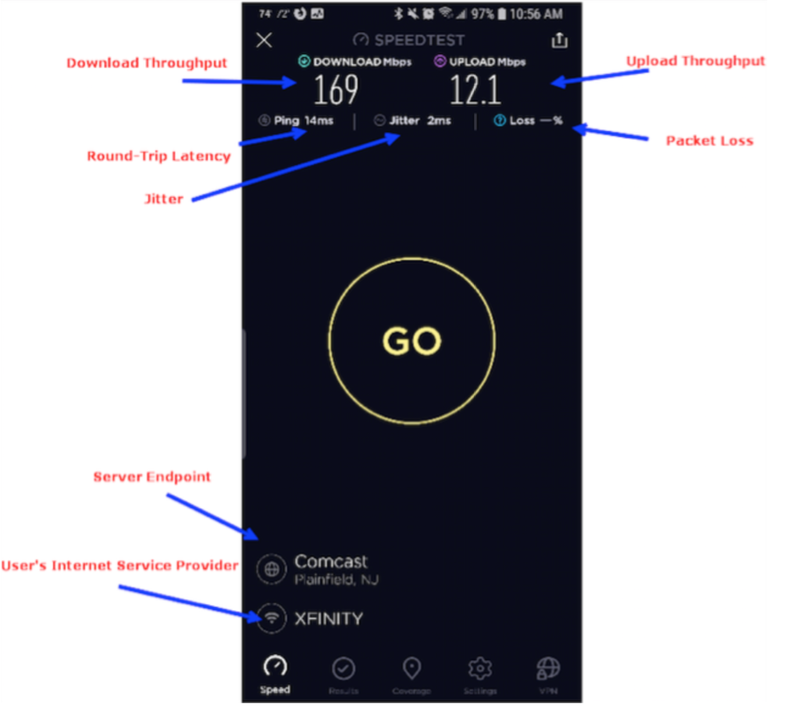
“Speed” Has Many Facets
Throughput (up, down)
Latency
Jitter
Packet Loss

Slide 4
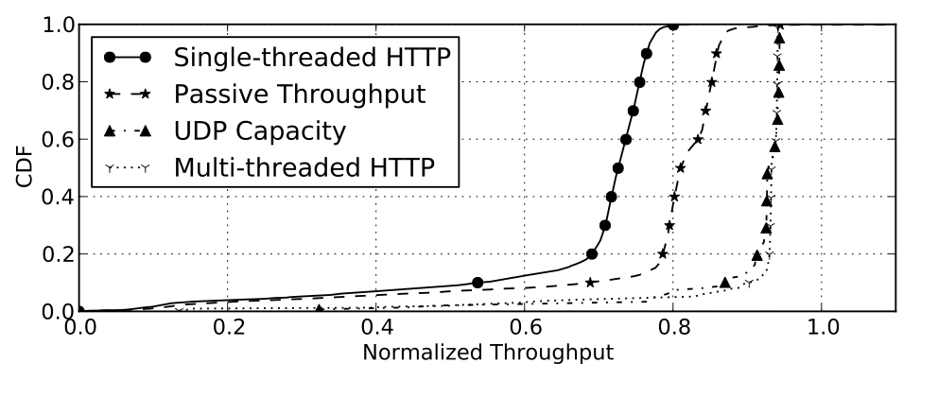
Different Techniques Measure Different Aspects of Speed
NDT Design: “Transport Capacity” (TCP New Reno)
Ookla, SamKnows Design: “Link Capacity”
Sundaresan, S., Burnett, S., Feamster, N., & De Donato, W. (2014, June). BISmark: A Testbed for Deploying Measurements and Applications in Broadband Access Networks. In USENIX Annual Technical Conference (pp. 383-394).
Sundaresan, S., De Donato, W., Feamster, N., Teixeira, R., Crawford, S., & Pescapè, A. (2011, August). Broadband internet performance: a view from the gateway. In ACM SIGCOMM (Vol. 41, No. 4, pp. 134-145). ACM.

Slide 5
Many Factors Limit a Client-Based Speed Test
Client device (hardware, software)
Home network
Network path
Measurement server infrastructure
Test parameters (length, # connections)

Slide 6
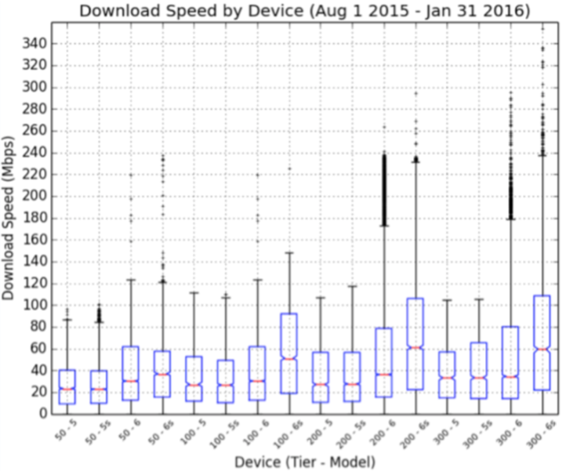
The Device Can be the Bottleneck
Older iPhones do not support 802.11ac, so never exceed 100 Mbps!

Slide 7
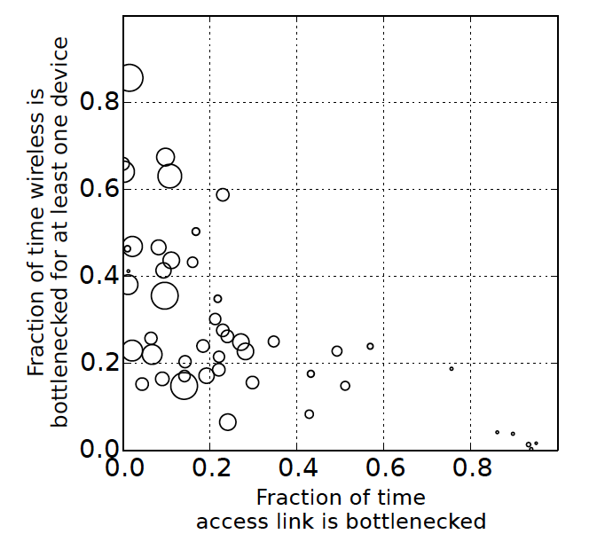
The Home Network Can Be the Bottleneck
Wireless bottlenecks are common, especially as throughput increases
Access link bottlenecks are rare, only happens at low throughput
Homes with throughput greater than 35 Mbits/s almost never see access link bottleneck. (2015)
Sundaresan, S., Feamster, N., & Teixeira, R. (2016, March). Home network or access link? locating last-mile downstream throughput bottlenecks. In International Conference on Passive and Active Network Measurement (pp. 111-123).

Slide 8
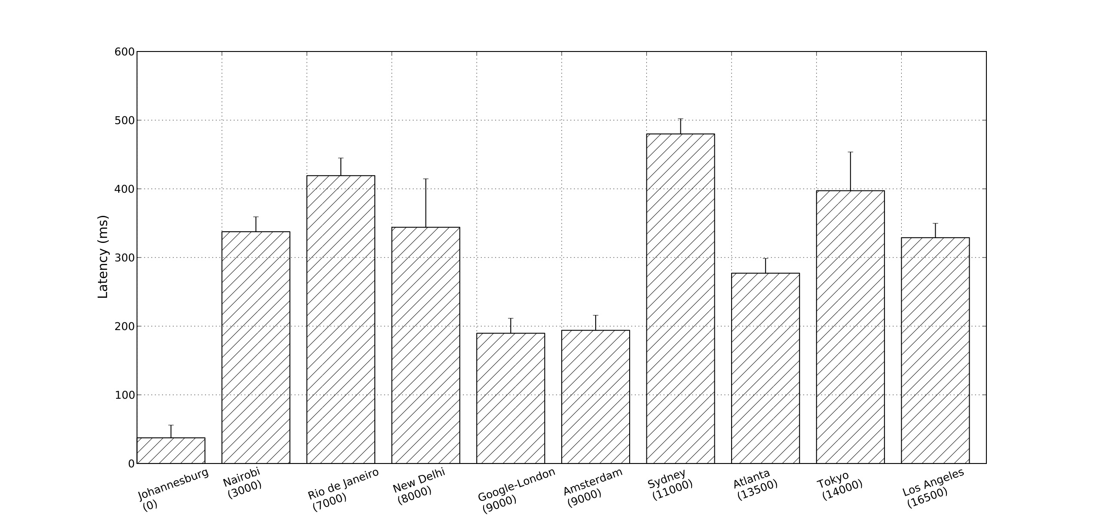
The Network Path can be the Bottleneck
Latencies from South Africa to Kenya, Brazil, India are 2x higher than latencies to Europe.
Connectivity to Australia, Japan also shows higher latency.
Gupta, A., Calder, M., Feamster, N., Chetty, M., Calandro, E., & Katz-Bassett, E. (2014, March). Peering at the Internet’s frontier: A first look at isp interconnectivity in Africa. In International Conference on Passive and Active Network Measurement (pp. 204-213).

Slide 9
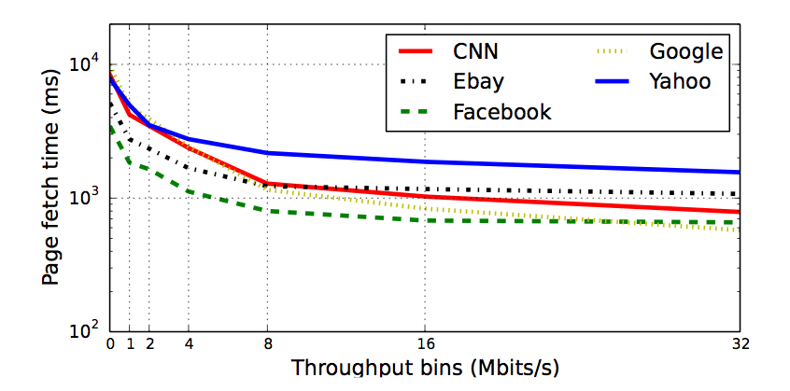
Faster Speed Doesn’t Mean Better Performance
Page load time stops improving above 16 Mbits per second.
Sundaresan, S., Feamster, N., Teixeira, R., & Magharei, N. (2013, October). Measuring and mitigating Web performance bottlenecks in broadband access networks. In ACM SIGCOMM Internet measurement conference (pp. 213-226). ACM. Community contribution award.

Slide 10
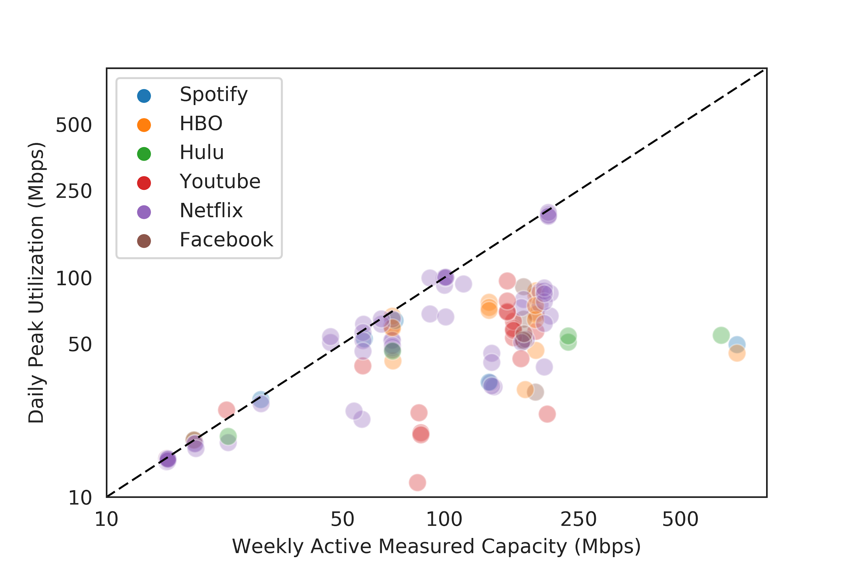
Application Performance Doesn’t Always Need “Top Speed”
Applications often do not consume link capacity.

Slide 11
User Experience Depends on Application Performance
Startup delay: How long does the video take to start playing?
Video resolution: What is the resolution of the video?
Bitrate changes: Does the video bitrate change during playback?
Rebuffering events: Does the video re-buffer during playback?
Notes:
We aim to infer four high-level application quality metrics that past work has indicated are good proxies for user experience.
(In actual fact, you’d also want to ask the users, and we’ve actually done that in part of our work using experience sampling, but we haven’t even looked at the data there yet, so I won’t talk about it today.)

Slide 12
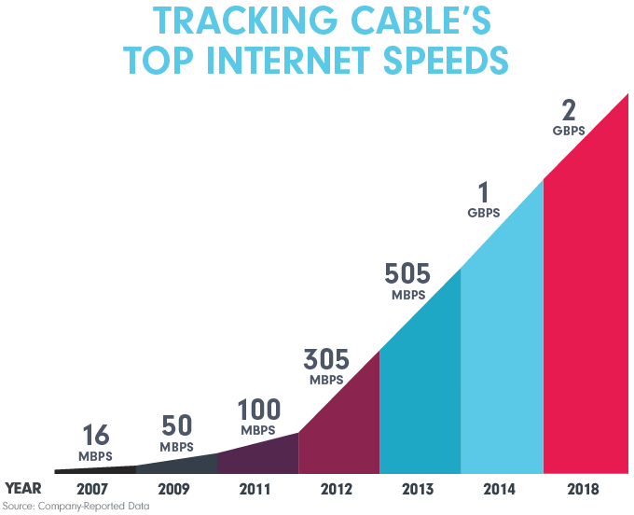
As Speeds Get Faster, Speed Testing Gets Harder
Measuring access links is getting harder.
Conventional tests take more data.
Bottlenecks are moving elsewhere.
Apps don’t saturate the access network capacity.
Notes:
This problem was never easy, but it’s getting more challenging!

Slide 13
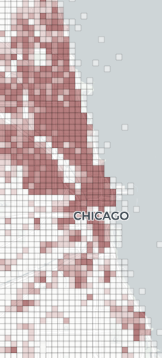
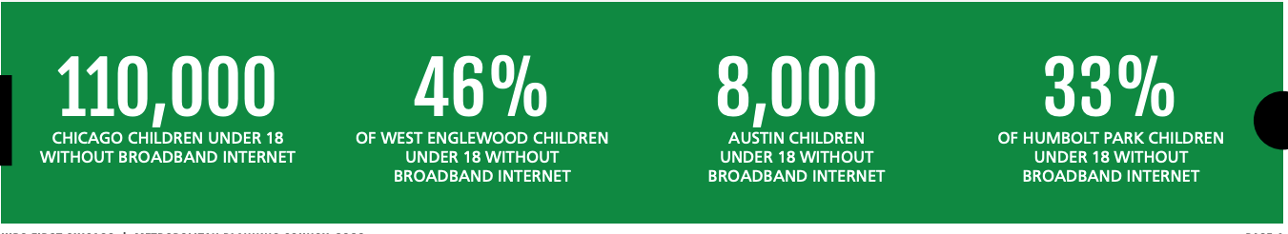
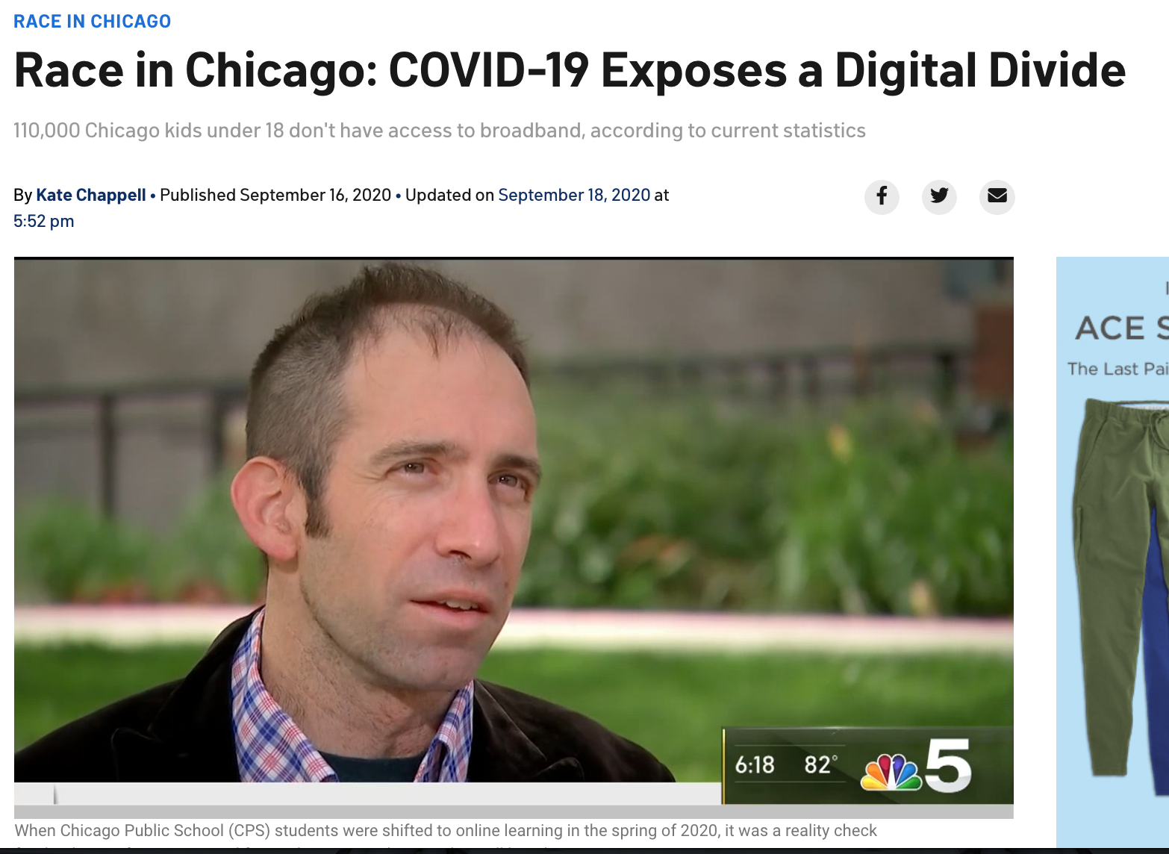
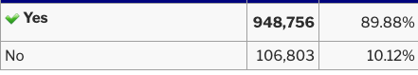
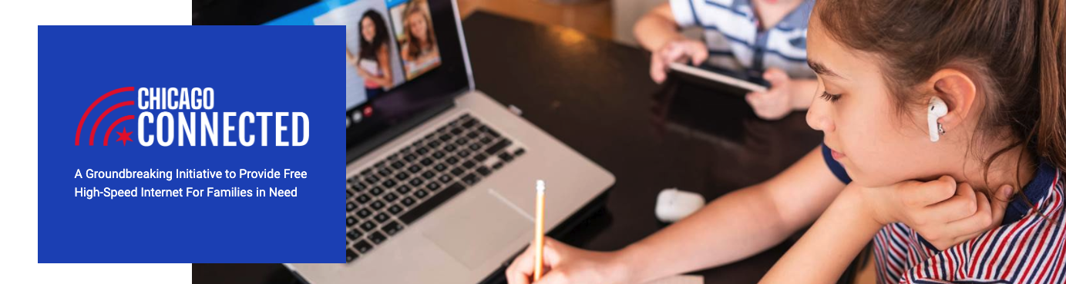
Closing the Digital Divide
No data!
Notes:
This is a national (in fact, a global) problem, but it also exists right here in Chicago, and is particularly acute right here on the south side, even in neighborhoods that border the university (e.g., Woodlawn, South Shore).

Slide 14
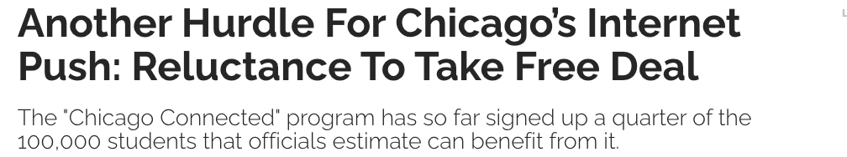
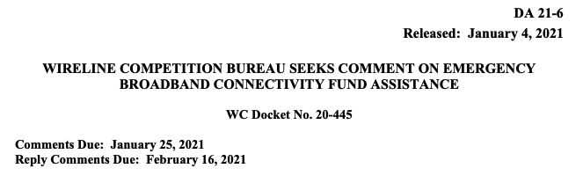


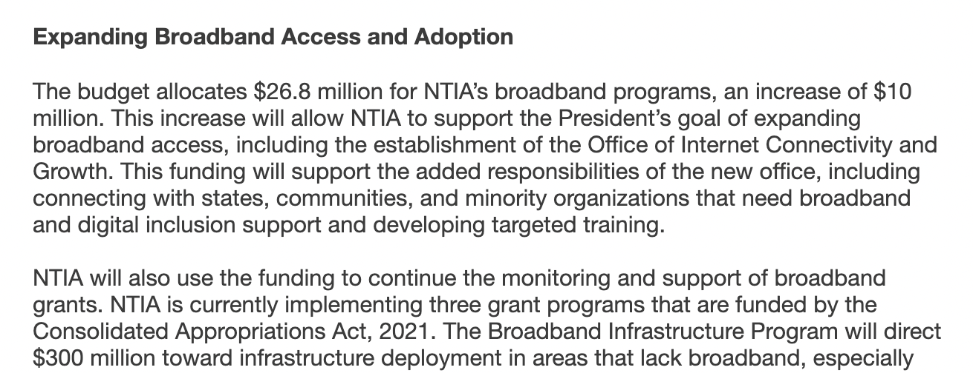
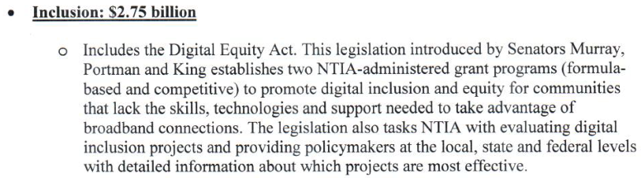
Investment is happening. It must be informed by foundational research and integrated with community fabric.
Foundational Data Science Discovery
Computer Science/Data Science
“Speed” (major data sampling challenges)
Performance: From the cloud to the last ten feet
Device quality: From poles to wearables
Quality of experience
Operations, performance, security
Policy and Social Science
Impact on life outcomes: education, health
Public/private partnerships: Internet as “public good”
Civil society: Internet as “human right”
Subsidies vs. infrastructure investment
Governance
Digital skills and use
Affordability, cost of access (or uptake, when free!)
Notes:
Data Science is not just a technical field. It has to situate technical
solutions (either hardware, software, or analytic modeling) within social
fabric. That means both the laws and rules of policymaking, and the social
practices of people on the ground in organizations and communities.

Slide 15
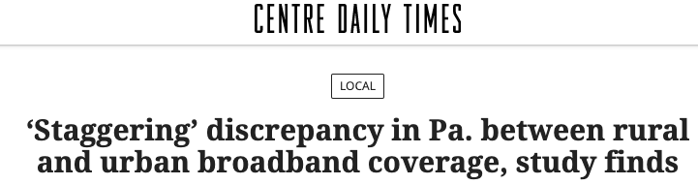
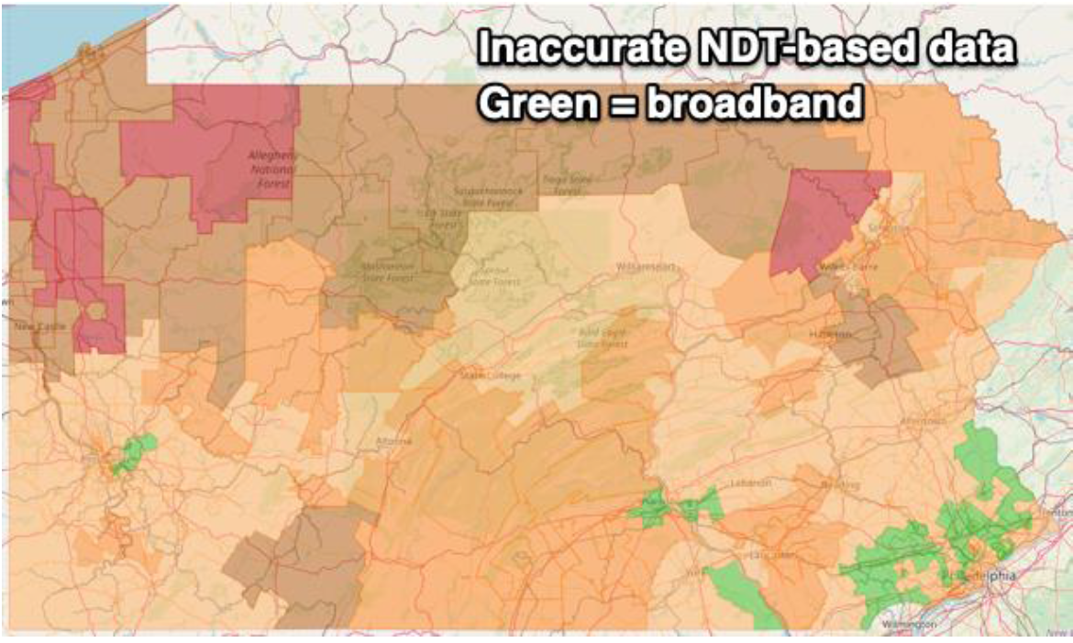
Bad Data: Garbage In, Garbage Out

Slide 16
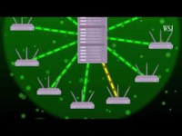
Many Problems with Found Data
Not just “dirty data”!
Root causes of bad data:
Technical method
Sampling method
Systematic errors
These are not fixable by removing bad values!
• Client device (hardware, software)
• Home network
• Network path
• Measurement server infrastructure
• Test parameters (length, # connections)

Slide 17
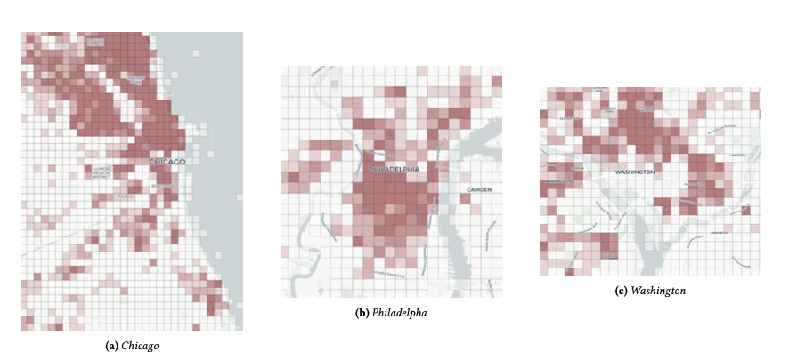
Limitation: Sampling Methodology

Slide 18
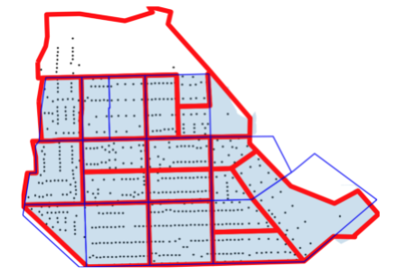
Sampling Frame for South Shore, Chicago

Slide 19
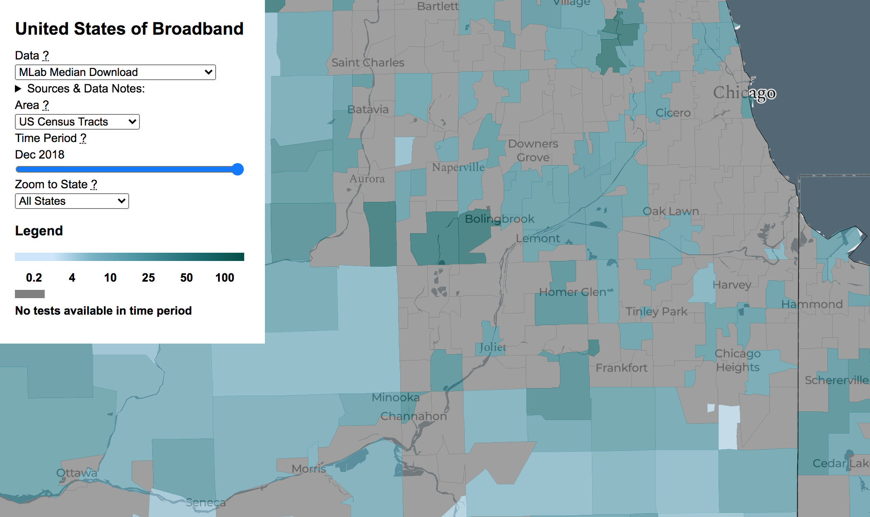
Limitation: Technical Methodology
M-Lab/
NDT
Reality
Methodological problems
Client-based test
Single-threaded test (NDT)
Infrastructure bottlenecks
Result: Severe underestimation of throughput values -> Bad conclusions!

Slide 20
Step 1: Define the Question with Stakeholders

Slide 21


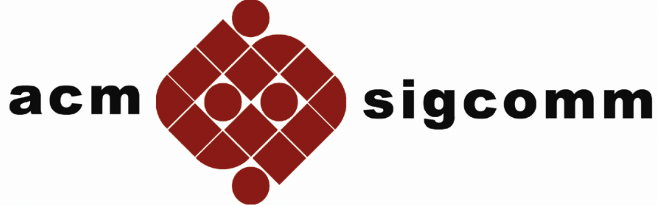
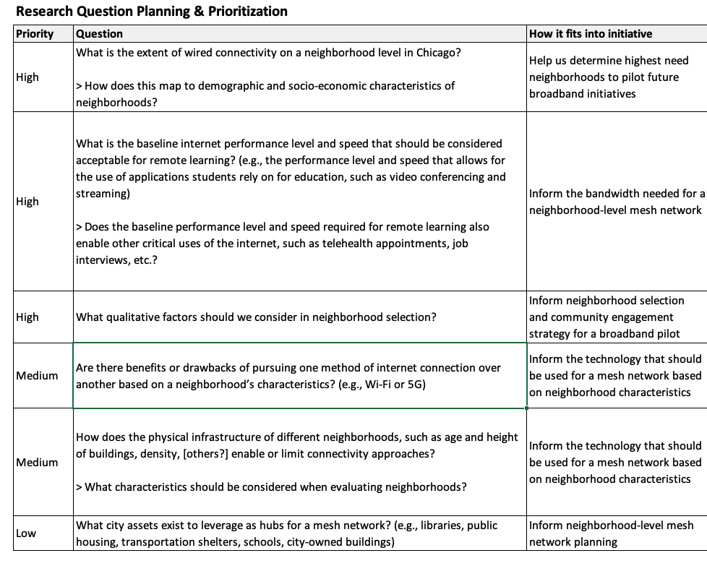
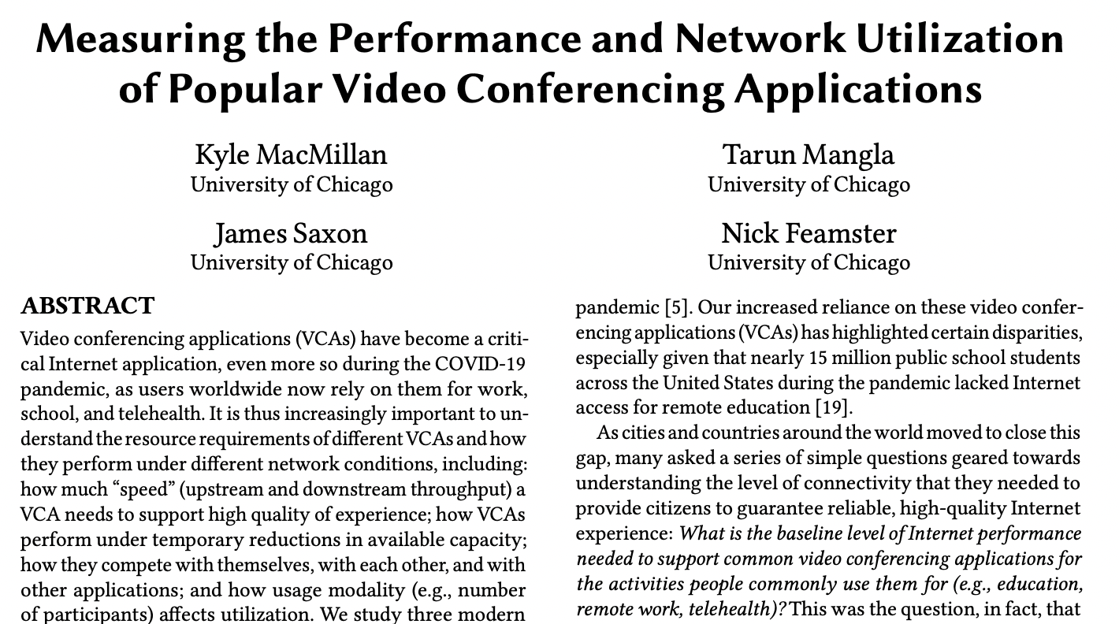
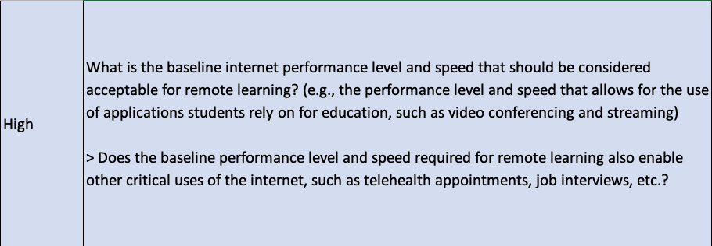
Stakeholders Define Questions
Notes:
Shaping research questions in relation to people.

Slide 22
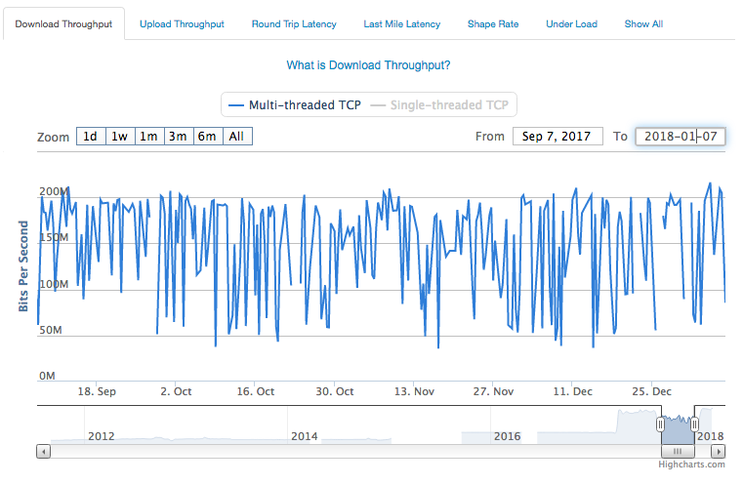
Getting Good Data Sometimes Requires a New System
Router-Based Speed Tests
Technical Standard: 10+ of research, methods now deployed by FCC, ISPs
Privacy Preserving: Statistical, AI-based inference of WiFi performance, ISP performance, application performance, activity, engagement using passive measurements without breaking encryption
Challenges:
Scale
Geographic/Network sampling
Tradeoffs between directness of measurement vs. privacy.
Application Performance Measurement

Slide 23
Step 2: Determine (and Create) Your Data Sources

Slide 24
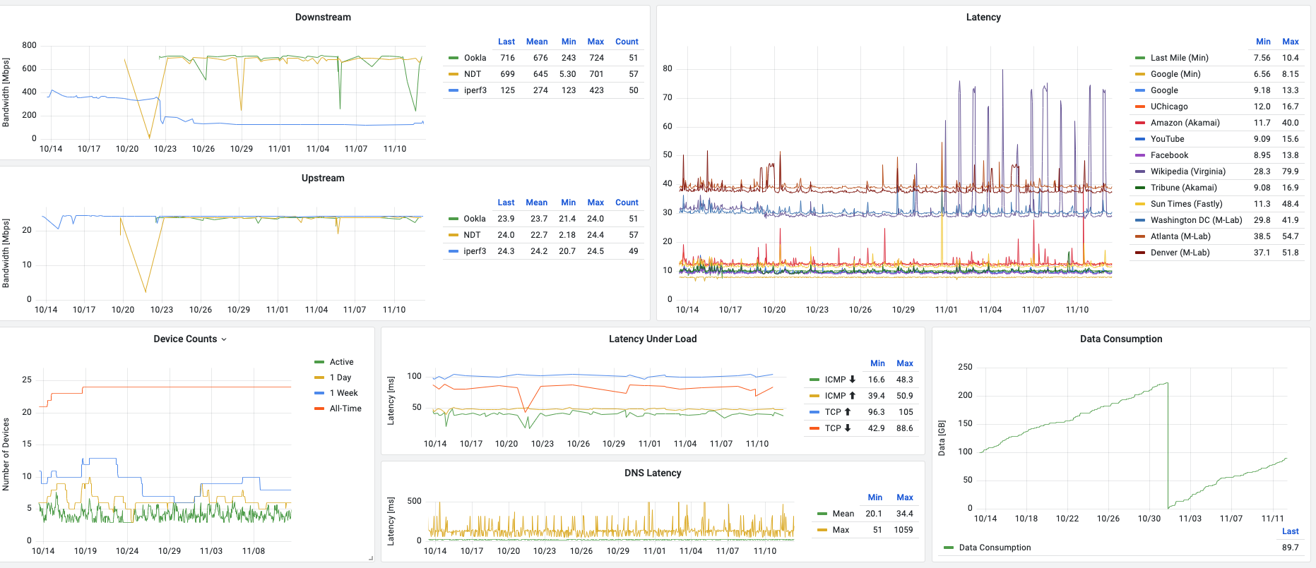

Slide 25
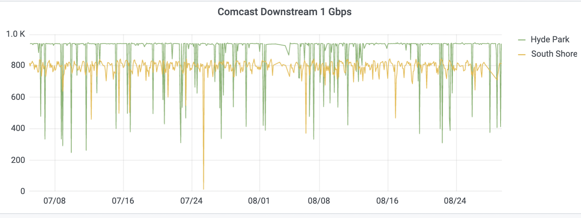
Insights: Same Service Plan ≠ Same Performance

Slide 26
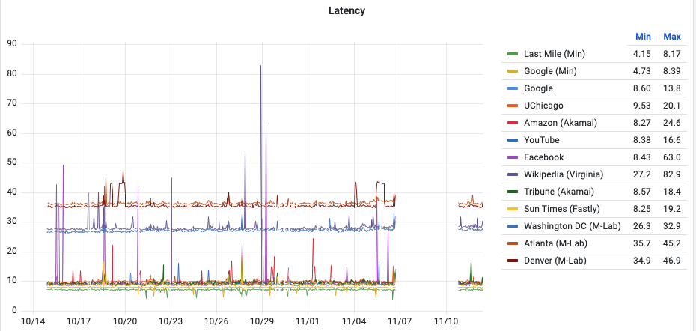

Slide 27
Step 3: Understand Tradeoffs and Limitations

Slide 28
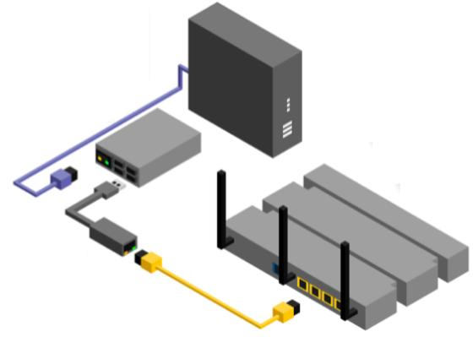
Example: Passive Monitoring Allows Great Insight into Application Performance
Estimate application performance using mostly passive measurements without breaking encryption
Device is in-line, between cable modem and user’s wireless router, or off-path
Implemented in Go for low-cost devices (Raspberry Pi, Odroid) on home networks
Past: Home network deployment (2019): ~60 in US, ~10 in Paris

Slide 29
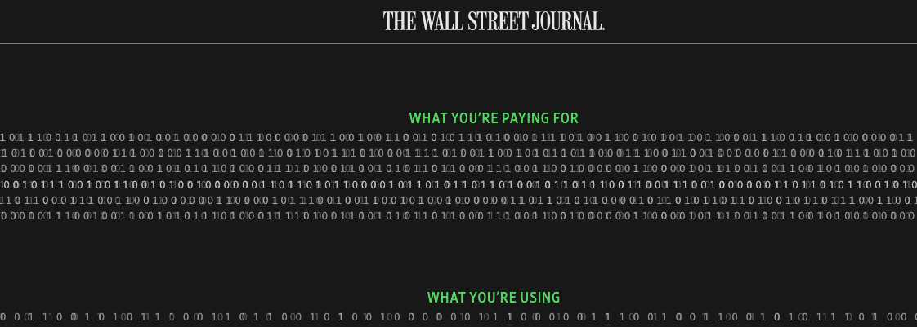
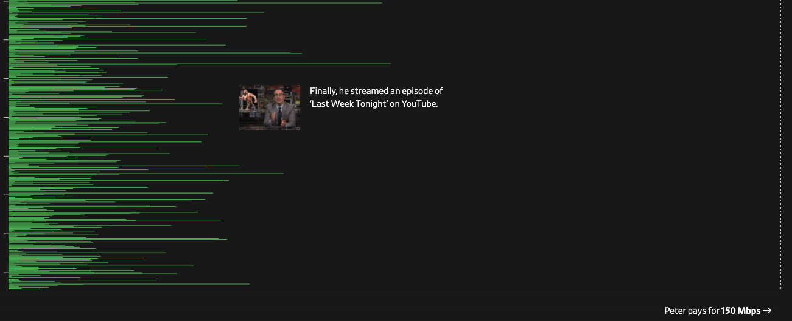





https://www.wsj.com/graphics/faster-internet-not-worth-it/

Slide 30
Passive Measurement Can Yield Important Insight
Examples (from recent study of video conferencing applications in the lab)
The average network utilization on an unconstrained link ranges from 0.8 Mbps to 1.9 Mbps.
Recovery times following transient drops in bandwidth depend on both All VCAs take at least 20 seconds to recover from severe uplink drops to 0.25 Mbps.
Differences in proprietary congestion control also create unfair bandwidth allocations in constrained bandwidth settings. Zoom and Meet can consume over 75% of the available downlink bandwidth when competing with Teams or a TCP flow.
Each participant’s video layout affects its own and others’ network utilization. Pinning a user’s video to the screen (speaker mode) leads to an increase in the user’s uplink utilization.

Slide 31
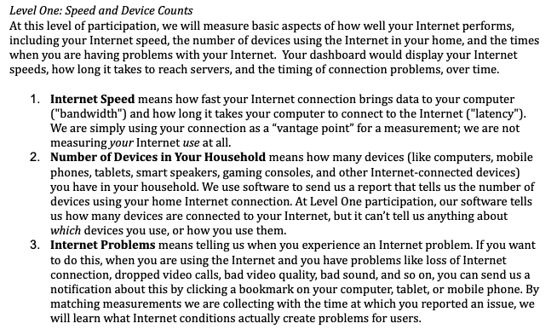
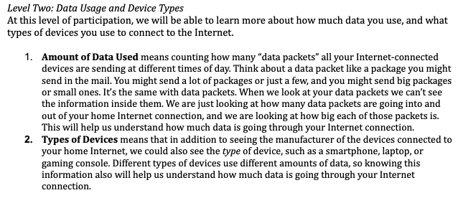
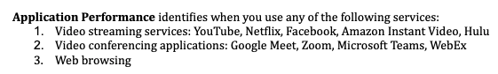
Privacy Tradeoffs
Application performance measurement often requires passive monitoring.
Installation of a measurement device in-home is ideal but…
Privacy Challenge: Unique trust and privacy issues, especially in underserved communities where levels of trust are low.

Slide 32
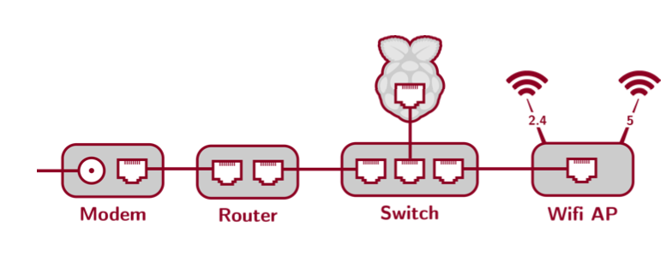
Deployment Tradeoffs

Slide 33
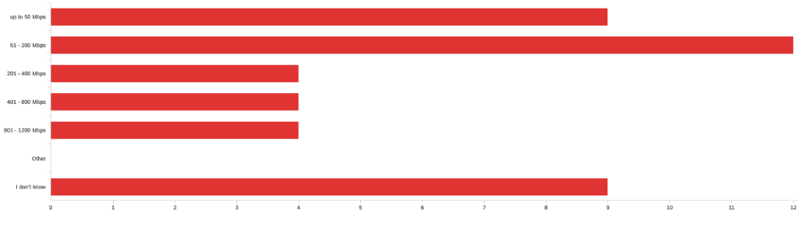
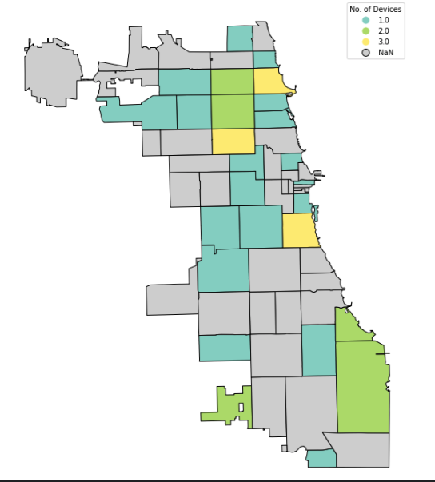
Current Deployment: Active Measurements Only
Based on 2018 deployment across NYC (passive study)
Pilot home network deployment in nearly 100 homes
Needed to defer passive measurement due to privacy concerns

Slide 34
Conclusion
Data science is about posing real-world questions, designing the systems to get the data that can answer them, grappling with those tradeoffs, and understanding limitations of the data.
It is not about tuning models on found datasets.
Addressing the digital divide poses many quintessential data science problems.

